Slide 1
Programming Language II CSE-215
Prof. Dr. Mohammad Abu Yousuf
yousuf@juniv.edu

Slide 2
Multithreaded Programming-2

Slide 3
Thread Scheduler in Java
Thread scheduler in java is the part of the JVM that decides which thread should run.
There is no guarantee that which runnable thread will be chosen to run by the thread scheduler.
Only one thread at a time can run in a single process.
The thread scheduler mainly uses preemptive or time slicing scheduling to schedule the threads.

Slide 4
Difference between preemptive scheduling and time slicing
Under preemptive scheduling, the highest priority task executes until it enters the waiting or dead states or a higher priority task comes into existence.
Under time slicing, a task executes for a predefined slice of time and then re-enters the pool of ready tasks. The scheduler then determines which task should execute next, based on priority and other factors.

Slide 5
Sleep method in java
The sleep() method of Thread class is used to sleep a thread for the specified amount of time.
Syntax of sleep() method in java
The Thread class provides a method for sleeping a thread:
public static void sleep(long miliseconds)throws InterruptedException

Slide 6
Example of sleep method in java
class TestSleepMethod1 extends Thread{
public void run(){
for(int i=1;i<5;i++){
try{
Thread.sleep(500);
}catch(Exception e){System.out.println(e);}
System.out.println(i);
}
}
public static void main(String args[]){
TestSleepMethod1 t1=new TestSleepMethod1();
TestSleepMethod1 t2=new TestSleepMethod1();
t1.start();
t2.start();
}
}
Output:
1
1
2
2
3
3
4
4
As you know well that at a time only one thread is executed. If you sleep a thread for the specified time, the thread scheduler picks up another thread and so on.

Slide 7
Can we start a thread twice?
No. After starting a thread, it can never be started again. If you does so, an IllegalThreadStateException is thrown. In such case, thread will run once but for second time, it will throw exception.
public class TestThreadTwice1 extends Thread{
public void run(){
System.out.println("running...");
}
public static void main(String args[]){
TestThreadTwice1 t1=new TestThreadTwice1();
t1.start();
t1.start();
}
}
Output:
running
Exception in thread "main" java.lang.IllegalThreadStateException

Slide 8
What if we call run() method directly instead start() method?
The start method makes sure the code runs in a new thread context. If you called run directly, then it would be like an ordinary method call and it would run in the context of the current thread instead of the new one. The start method contains the special code to trigger the new thread; run obviously doesn't have that ability because you didn't include it when you wrote the run method.

Slide 9
What if we call run() method directly instead start() method?
Each thread starts in a separate call stack.
Invoking the run() method from main thread, the run() method goes onto the current call stack rather than at the beginning of a new call stack.
class TestCallRun1 extends Thread{
public void run(){
System.out.println("running...");
}
public static void main(String args[]){
TestCallRun1 t1=new TestCallRun1();
t1.run();//fine, but does not start a separate call stack
}
}
Output:
running...

Slide 10

Problem if you direct call run() method
class TestCallRun2 extends Thread{
public void run(){
for(int i=1;i<5;i++){
try{Thread.sleep(500);}catch(InterruptedException e){System.out.println(e);}
System.out.println(i);
}
}
public static void main(String args[]){
TestCallRun2 t1=new TestCallRun2();
TestCallRun2 t2=new TestCallRun2();
t1.run();
t2.run();
}
}
As you can see in the above program that there is no context-switching because here t1 and t2 will be treated as normal object not thread object.

Slide 11
The join() method
Java join() method can be used to pause the current thread execution until unless the specified thread is dead. In other words, it causes the currently running threads to stop executing until the thread it joins with completes its task.
Syntax:
public void join()throws InterruptedException
public void join(long milliseconds)throws InterruptedException
Example of join(long miliseconds) method (Next slide)

Slide 12
class TestJoinMethod1 extends Thread{
public void run(){
for(int i=1;i<=5;i++){
try{
Thread.sleep(500);
}catch(Exception e){System.out.println(e);}
System.out.println(i);
}
}
public static void main(String args[]){
TestJoinMethod1 t1=new TestJoinMethod1();
TestJoinMethod1 t2=new TestJoinMethod1();
TestJoinMethod1 t3=new TestJoinMethod1();
t1.start();
try{
t1.join()
}catch(Exception e){System.out.println(e);}
t2.start();
t3.start();
}
}
Example 1
Output:1
2
3
4
5
1
1
2
2
3
3
4
4
5
5
In the above example, when t1 completes its task then t2 and t3 starts executing.

Slide 13

class TestJoinMethod2 extends Thread{
public void run(){
for(int i=1;i<=5;i++){
try{
Thread.sleep(500);
}catch(Exception e){System.out.println(e);}
System.out.println(i);
}
}
public static void main(String args[]){
TestJoinMethod2 t1=new TestJoinMethod2();
TestJoinMethod2 t2=new TestJoinMethod2();
TestJoinMethod2 t3=new TestJoinMethod2();
t1.start();
try{
t1.join(1500);
}catch(Exception e){System.out.println(e);}
t2.start();
t3.start();
}
}
Example 2
In the above example, when t1 is completes its task for 1500 miliseconds(3 times) then t2 and t3 starts executing.

Slide 14
getName(),setName(String) and getId() method:
public String getName()
public void setName(String name)
public long getId()

Slide 15
class TestJoinMethod3 extends Thread{
public void run(){
System.out.println("running...");
}
public static void main(String args[]){
TestJoinMethod3 t1=new TestJoinMethod3();
TestJoinMethod3 t2=new TestJoinMethod3();
System.out.println("Name of t1:"+t1.getName());
System.out.println("Name of t2:"+t2.getName());
System.out.println("id of t1:"+t1.getId());
t1.start();
t2.start();
t1.setName(“ICT");
System.out.println("After changing name of t1:"+t1.getName());
}
}
Output:
Name of t1:Thread-0
Name of t2:Thread-1
id of t1:8
running...
After changling name of t1: ICT
running...

Slide 16
Creating Thread by Implementing Runnable
1) The easiest way to create a thread is to create a class that implements the Runnable interface.
2) The Runnable interface should be implemented by any class whose instances are intended to be executed by a thread.
3)To implement Runnable, a class need only implement a single method called run(), which is declared like this:
public void run( )

Slide 17
Creating Thread by Implementing Runnable
After you create a class that implements Runnable, you will instantiate an object of type Thread from within that class. Thread defines several constructors. The one that we will use is shown here:
Thread(Runnable threadOb, String threadName)
In this constructor, threadOb is an instance of a class that implements the Runnable interface. The name of the new thread is specified by threadName.

Slide 18
Creating Thread by Implementing Runnable
After the new thread is created, it will not start running until you call its start() method, which is declared within Thread.
In essence, start() executes a call to run().
The start() method is shown here:
void start()

Slide 19
Example that creates a new thread and starts it running
class RunnableDemo implements Runnable
{ private Thread t;
private String threadName;
RunnableDemo( String name) {
threadName = name;
System.out.println("Creating " + threadName );
}
public void run() {
System.out.println("Running " + threadName );
try {
for(int i = 4; i > 0; i--) {
System.out.println("Thread: " + threadName + ", " + i);
// Let the thread sleep for a while.
Thread.sleep(50); }
}catch (InterruptedException e) {
System.out.println("Thread " + threadName + " interrupted.");
}
System.out.println("Thread " + threadName + " exiting.");
}
public void start () {
System.out.println("Starting " + threadName );
if (t == null) {
t = new Thread (this, threadName);
t.start (); }
}
}

Slide 20
Example that creates a new thread and starts it running
public class TestThread {
public static void main(String args[]) {
RunnableDemo R1 = new RunnableDemo( "Thread-1");
R1.start();
RunnableDemo R2 = new RunnableDemo( "Thread-2");
R2.start();
}
}

Slide 21
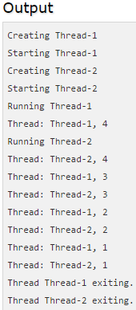
Example that creates a new thread and starts it running

Slide 22
class ThreadDemo extends Thread {
private Thread t;
private String threadName;
ThreadDemo( String name) {
threadName = name;
System.out.println("Creating " + threadName );
}
public void run() {
System.out.println("Running " + threadName );
try {
for(int i = 4; i > 0; i--) {
System.out.println("Thread: " + threadName + ", " + i);
// Let the thread sleep for a while.
Thread.sleep(50);
}
}catch (InterruptedException e) {
System.out.println("Thread " + threadName + " interrupted.");}
System.out.println("Thread " + threadName + " exiting.");
}
public void start () {
System.out.println("Starting " + threadName );
if (t == null) {
t = new Thread (this, threadName);
t.start ();
} }
}
preceding program rewritten to extend the Thread

Slide 23
Preceding program rewritten to extend the Thread
public class TestThread {
public static void main(String args[]) {
ThreadDemo T1 = new ThreadDemo( "Thread-1");
T1.start();
ThreadDemo T2 = new ThreadDemo( "Thread-2");
T2.start();
}
}

Slide 24
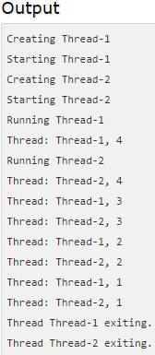
Preceding program rewritten to extend the Thread

Slide 25
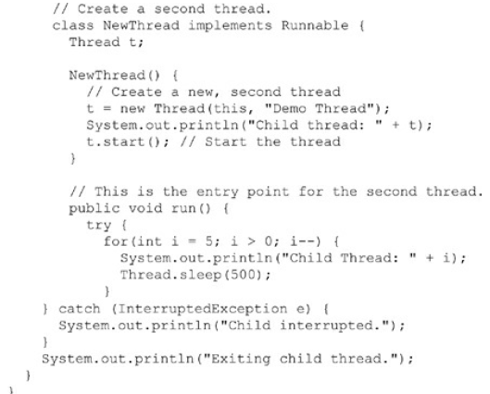
Example that creates a new thread and starts it running

Slide 26
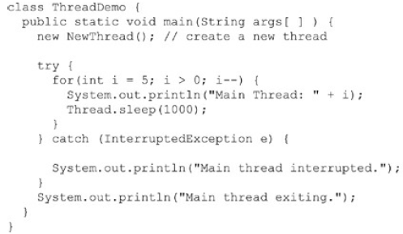
Example that creates a new thread and starts it running

Slide 27
Example that creates a new thread and starts it running
Inside NewThread’s constructor, a new Thread object is created by the following statement:
t = new Thread(this, "Demo Thread");
Passing this as the first argument indicates that you want the new thread to call the run( ) method on this object.
Next, start() is called, which starts the thread of execution beginning at the run( ) method.

Slide 28
Example that creates a new thread and starts it running
This causes the child thread’s for loop to begin.
After calling start(), NewThread’s constructor returns to main().
When the main thread resumes, it enters its for loop. Both threads continue running, sharing the CPU in single-core systems, until their loops finish.

Slide 29
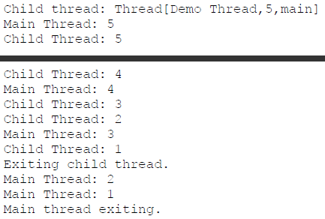
Example that creates a new thread and starts it running
Out put of previous program:

Slide 30
Example that creates a new thread and starts it running
As mentioned earlier, in a multithreaded program, often the main thread must be the last thread to finish running. In fact, for some older JVMs, if the main thread finishes before a child thread has completed, then the Java run-time system may “hang.”
The preceding program ensures that the main thread finishes last, because the main thread sleeps for 1,000 milliseconds between iterations, but the child thread sleeps for only 500 milliseconds. This causes the child thread to terminate earlier than the main thread.
Shortly, you will see a better way to wait for a thread to finish.

Slide 31
Creating Thread by Extending Thread Class
The second way to create a thread is to create a new class that extends Thread, and then to create an instance of that class.
The extending class must override the run() method, which is the entry point for the new thread.
It must also call start() to begin execution of the new thread.

Slide 32
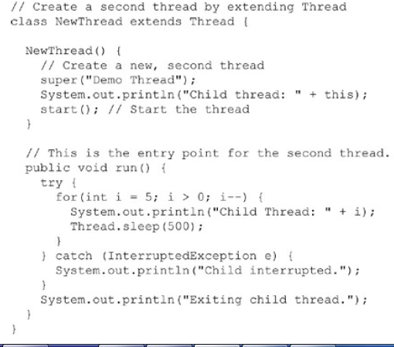
Preceding program rewritten to extend Thread

Slide 33
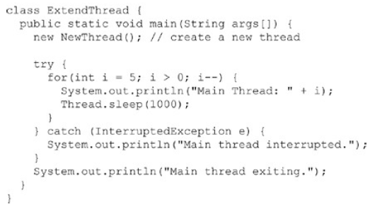
Preceding program rewritten to extend Thread

Slide 34
Preceding program rewritten to extend Thread
This program generates the same output as the preceding version.
Here, child thread is created by instantiating an object of NewThread, which is derived from Thread.
Notice the call to super( ) inside NewThread. This invokes the following form of the Thread constructor:
public Thread(String threadName)
Here, threadName specifies the name of the thread.

Slide 35
Creating Multiple Threads
So far, you have been using only two threads: the main thread and one child thread.
However, your program can spawn as many threads as it needs. For example, the following program creates three child threads:

Slide 36
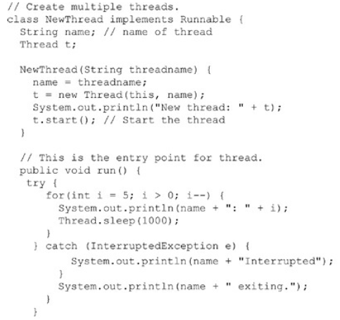

Slide 37
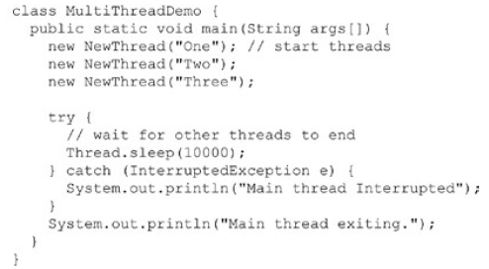
Creating Multiple Threads

Slide 38
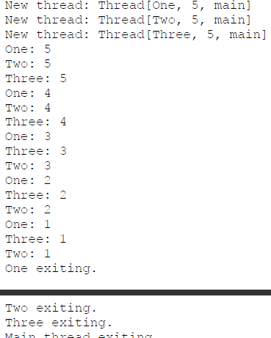
Sample output from this program is shown here.

Slide 39
Creating Multiple Threads
As you can see, once started, all three child threads share the CPU.
Notice the call to sleep(10000) in main( ). This causes the main thread to sleep for ten seconds and ensures that it will finish last.

Slide 40
Thank you

